Slide 1

UNIX SHELL PROGRAMMING
LINKS AND INODES
PREETHI.P
Department of Computer Science and
Engineering

Slide 2

UNIX SHELL PROGRAMMING
LINKS AND INODES
PREETHI.P
Department of Computer Science and Engineering

Slide 3
UNIX SHELL PROGRAMMING
LINKS AND INODES
Topics to Discuss:
1. Hard links
2. Soft links
3. Inode

Slide 4
UNIX SHELL PROGRAMMING
INODES
Every file is associated with a table called INODE.
Accessed using Inode number.
Contains – File type,
File Permission
Number of Links
The UID of the owner
GID of the Group Owner
File Size
Date and Time - Last modification
Date and Time - Last access
Date and Time - Last change of the inode
An array of pointers that keep track of disk blocks used

Slide 5
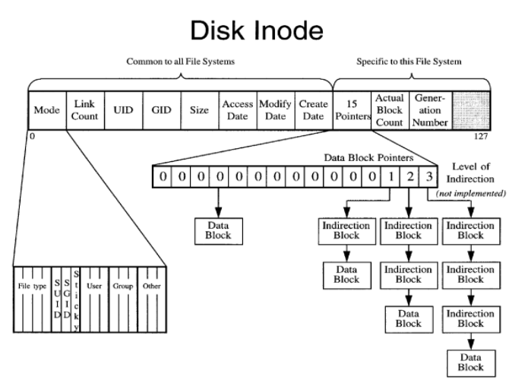
UNIX SHELL PROGRAMMING
INODES
Image ref: http://web.cs.ucla.edu/

Slide 6
UNIX SHELL PROGRAMMING
INODES
NOTES:
Inode table wont have file name or inode number
Directory file maintains the file name and inode number
Command with filename : Behaviour of Kernel
Inode number is unique in the Single file system.
Use of ls – i
Case study: Describe the Working of command vi note1 where note1 exists.

Slide 7
UNIX SHELL PROGRAMMING
LINKS
File having multiple names stored in common inode number and with one link.
Types are : Hard Link and Soft Link
All attributes seem to be identical but the file names.

Slide 8
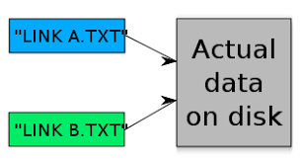
UNIX SHELL PROGRAMMING
LINKS : creating hard links
A file is linked with ln command. The command can create both hard and soft links.
Ln filename1 fileame2
Ln no* Dir

Slide 9
UNIX SHELL PROGRAMMING
LINKS : Where to use hard links
You have written a number of programs which refer to foo.txt. Later you move your directory to some other destination. When you run your programs the foo.txt does not exists in original location ?
just link foo.txt to the old directory.
2 . Links acts as a back up

Slide 10
UNIX SHELL PROGRAMMING
SYMBOLIC LINK
Why Symbolic link:
With Hard Link
You can not have two linked filenames in two file systems.
You can not link a directory with in the same file system.
This limitation can be overcome by symbolic link.
Symbolic link provides path name of the file that pointed to.
It is also called as Soft Link

Slide 11
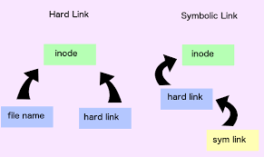
UNIX SHELL PROGRAMMING
SYMBOLIC LINK
ln –s filename1 filename2
Observe the same using ls –il
You can see the changes in the attributes indicating symbolic link.
File type l, File size 4 (size of path name) and file name having -> symbol
Image ref: medium.com

Slide 12
UNIX SHELL PROGRAMMING
SYMBOLIC LINK
Note:
Exists two files but not same
Removing a symbolic link will not affect much
Removing original file would make symbolic link to a dangling pointer
Symbolic links can be used with relative path names
Can span multiple file systems
Inode number is :
Can be connected to directories ?

Slide 13
THANK YOU
PREETHI.P
Assistant Professor , Department of Computer Science
preethip@pes.edu

